Slide 1


Linux Scheduling Algorithm
-Ashish Singh

Slide 2

Introduction
History and Background
Linux Scheduling
Modification in Linux Scheduling
Results
Conclusion
References
Questions

Slide 3
History and Background
In 1991 Linus Torvalds took a college computer science course that used the Minix operating system
Minix is a “toy” UNIX-like OS written by Andrew Tanenbaum as a learning workbench
Linus went in his own direction and began working on Linux
In October 1991 he announced Linux v0.02
In March 1994 he released Linux v1.0

Slide 4
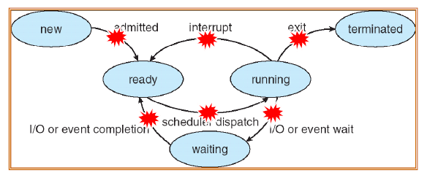
Scheduling in Linux
Time Sharing System-magical effect by switching from one process to the other in short time frame.
Question – when to switch and what process?
Notes:
-Like any time-sharing system, Linux achieves the magical effect of an apparent simultaneous execution of multiple processes by switching from one process to another in a very short time frame.
-Scheduling, which is concerned with when to switch and which process to choose.

Slide 5
Linux Approach
Process run concurrently – CPU time divided into slices, one for each process.
If current process is not terminated when its time quantum expires – switch process.
Notes:
several processes are allowed to run "concurrently," which means that the CPU time is roughly divided into "slices," one for each runnable process.Of course, a single processor can run only one process at any given instant. If a currently running process is not terminated when its time slice or quantum expires, a process switch may take place. Time-sharing relies on timer interrupts and is thus transparent to processes.

Slide 6
Linux Approach
General Systems – algorithms to derive priority of process, end result – process assigned a value
Linux – process priority is dynamic. Scheduler increases/decreases the priority.
Notes:
Complicated algorithms are sometimes used to derive the current priority of a process, but the end result is the same: each process is associated with a value that denotes how appropriate it is to be assigned to the CPU.
In Linux, process priority is dynamic. The scheduler keeps track of what processes are doing and adjusts their priorities periodically; in this way, processes that have been denied the use of the CPU for a long time interval are boosted by dynamically increasing their priority. Correspondingly, processes running for a long time are penalized by decreasing their priority.

Slide 7

Process Scheduling
Linux uses two process-scheduling algorithms:
  A time-sharing algorithm for fair preemptive scheduling between multiple processes
  A real-time algorithm for tasks where absolute priorities are more important than fairness
A process’s scheduling class defines which algorithm to apply
For time-sharing processes, Linux uses a prioritized, credit based algorithm
  The crediting rule
  factors in both the process’s history and its priority
Notes:
When all processes have credit = 0, recrediting occurs
Based on factors including priority and history

Slide 8
Process Scheduling
Linux implements the FIFO and round-robin real-time scheduling classes; in both cases, each process has a priority in addition to its scheduling class
  The scheduler runs the process with the highest priority; for equal-priority processes, it runs the process waiting the longest
  FIFO processes continue to run until they either exit or block

Slide 9
Priorities: Linux 2.4 Scheduling
• Static priority
The maximum size of the time slice a process should be allowed
before being forced to allow other processes to compete for the
CPU.
• Dynamic priority
The amount of time remaining in this time slice; declines with
time as long as the process has the CPU.
When its dynamic priority falls to 0, the process is marked for
rescheduling.
• Real-time priority
Only real-time processes have the real-time priority.
Higher real-time values always beat lower values

Slide 10
Linux Scheduling
Process Selection
  most deserving process is selected by the scheduler
  real time processes are given higher priority than ordinary processes
  when several processes have the same priority, the one nearest the front of the run queue is chosen
  when a new process is created the number of ticks left to the parent is split in two halves, one for the parent and one for the child
  priority and counter fields are used both to implement time-sharing and to compute the process dynamic priority

Slide 11
Linux Scheduling
Actions performed by schedule( )
  Before actually scheduling a process, the schedule( ) function starts by running the functions left by other kernel control paths in various queues
  The function then executes all active unmasked bottom halves
Scheduling
  value of current is saved in the prev local variable and the need_resched field of prev is set to 0
  a check is made to determine whether prev is a Round Robin real-time process. If so, schedule( ) assigns a new quantum to prev and puts it at the bottom of the runqueue list
  if state is TASK_INTERRUPTIBLE, the function wakes up the process
  schedule( ) repeatedly invokes the goodness( ) function on the runnable processes to determine the best candidate
  when counter field becomes zero, schedule( ) assigns to all existing processes a fresh quantum, whose duration is the sum of the priority value plus half the counter value

Slide 12
Goodness Function in Scheduling Algorithm
  goodness( ) function
    identify the best candidate among all processes in the runqueue list.
    It receives as input parameters prev (the descriptor pointer of the previously running process) and p (the descriptor pointer of the process to evaluate)
    The integer value c returned by goodness( ) measures the "goodness" of p and has the following meanings:
      c = -1000, p must never be selected; this value is returned when the runqueue list contains only init_task
      c =0, p has exhausted its quantum. Unless p is the first process in the runqueue list and all runnable processes have also exhausted their quantum, it will not be selected for execution.
      0 < c < 1000, p is a conventional process that has not exhausted its quantum; a higher value of c denotes a higher level of goodness.
      c >= 1000, p is a real-time process; a higher value of c denotes a higher level of goodness.

Slide 13
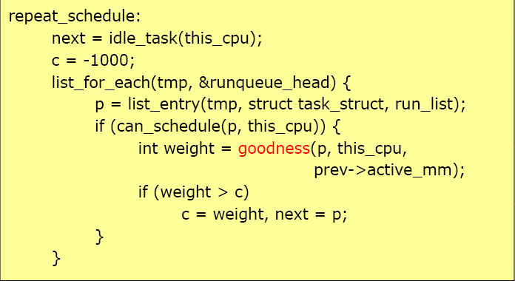
Selecting the next Process

Slide 14
Two Level Implementation
The first level scheduler selects a set of processes, a batch, to be scheduled for a specified amount of time. Rather than selecting a constant number of processes for each batch, the processes selected are based on the system load to avoid any subsystem (PE or I/O) to be idle.
The first level scheduler keeps processes in two lists: a ready queue and an expired queue. These queues are used to guarantee fairness. All new processes are placed on the ready queue and processes to be scheduled are selected from this queue. When a process has been scheduled for a defined period of time, Crq, the process is removed from the run queue, in the second level scheduler, and placed on the expired queue.

Slide 15
Two Level Implementation
When the ready queue becomes empty, all processes from the expired queue are moved to the ready queue. This is repeated indefinitely. While processes are executed, the system keeps track of time spent in the running state and blocked state for each process.
UPE += Trunning(p)/Tblocked(p) and UIO += 1 - (Trunning(p)/Tblocked(p))
Notes:
Utilization values are updated.

Slide 16
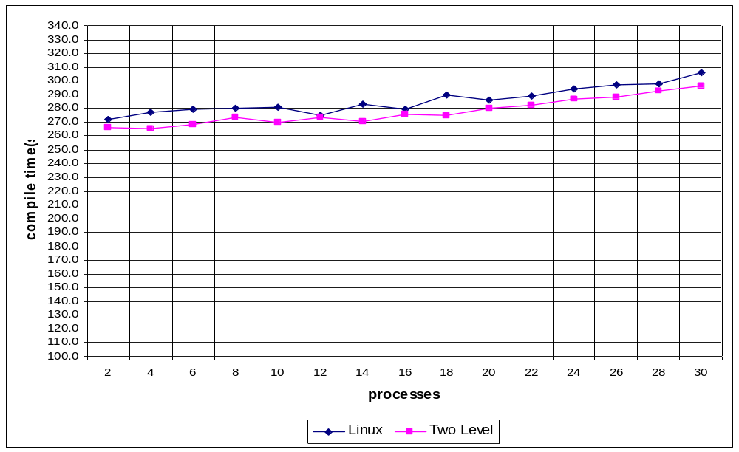
Linux Vs Two Level

Slide 17
Limitations
It has not been possible to improve the Linux scheduler through modifications like this, while maintaining all of the advantages in the existing Linux scheduler.
It is hypothesized that if knowledge of the type of jobs which would be executed on the system exists, this could be used to compile-time select the scheduler, which is the most efficient for the specific job-mix and usage.

Slide 18
Advantages
Linux scheduler: Suitable for standard workstation use where few processes is in the running or ready state at a time, as this proves very good response times.
Two-level Scheduler: Suitable for systems in where a very high load can exist, and resources are scarce compared to the load of the system.
Notes:
Interactive process like web servers should not be used.

Slide 19
Conclusion
Two-level scheduling is implemented by suspending a set of processes for longer periods of time. While the load is low, this algorithm performs exactly as the Linux scheduler though a slightly administrative overhead is introduced in the first-level scheduling.
Hypothesized that if used it reduces thrashing.

Slide 20
References
[1] Silberschatz, A., P.B. Galvin, and G. Gagne, "Chapter 6 CPU Scheduling, Operating System Concepts, Sixth Ed.," John Wiley & Son, 2003.
[2] Daniel P. Bovet & Marco Cesati, "Chapter 10, Processing Scheduling, Understanding the Linux Kernel," 2000.
[3] Sivarama P. Dandamudi and Samir Ayachi. Performance of hierarchical processor scheduling in shared-memory multiprocessor systems". IEEE Transactions on Computers, 48(11):1202–1213, 1999. DA99
[4] S. Haldar and D. K. Subramanian. Fairness in processor scheduling in time sharing systems. Operating Systems Review, Vol 25. Issue 1.:4–18, 1991. HS91
[5] http://www.answers.com/Two-level%20scheduling
[6] http://www.kernel.org/pub/linux/kernel/v2.4/linux-2.4.18.tar.gz
[7]John O'Gorman, Chapter 7, Scheduling, The Linux Process Manager, 2003.

